Slide 1


City of San Antonio DCI Project
By: The University of Texas at San Antonio

Slide 2

Objective
Reproduce the Distressed Communities Index (DCI) developed by Economic Innovation Group (EIG) [Platform: PowerPoint]
Explore the data around the country [Platform: Tableau]

Slide 3
DCI Components
Seven Components used to calculate DCI
No High School Diploma
Housing Vacancy
Unemployment Rate
Poverty Rate
Median Income compared to statewide median income
Change in Employment from 2011 to 2015
Change in Businesses from 2011 to 2015

Slide 4
Data Sources
U.S. Census Bureau
Not the decennial enumeration of every resident
American Communities Survey
3 million residents per year ~ 1%
Statistical estimates with margins of error
Started in 2005, currently available since 2010
Business Patterns
Based on Census Business Register
Excludes self-employed, domestic employees, underground economy
Currently available since 1994

Slide 5

Calculating the DCI
Download raw data
Sort and rank zip codes by raw values
Average DCI components ranks by zip code
Sort and rank zip codes by averages
Calculate DCI percentile:
Notes:
Download raw data for each component from the U.S. Census Bureau
Sort zip codes by raw value of each component and rank the zip codes with 1 being the most desirable raw value

Slide 6
Final Data Set
EIG reported on 26,126 zip codes. UTSA created a data set with 26,125 zip codes as follows:
Eliminate all zip codes with populations under 500 people
Eliminate all zip codes that have missing data
Exception: replace missing “Change in employment” with “Change in business” for that zip code

Slide 7
Validation Measures of Data
Pulled random zip codes to compare UTSA’s data with EIG’s values on their interactive map
Confirmed methodology with EIG’s Research Director

Slide 8
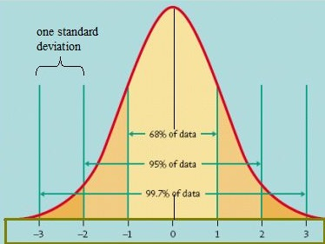
Data values don’t always form a normal bell curve
but they often are mostly in the center

Slide 9
Seven DCI Components
Graphs of raw values (e.g. 0% - 100%) versus ranking (1 - 26125)
How do changes in raw values affect ranking?
The spread within San Antonio is almost as wide as the spread nationwide
For future reference

Slide 10
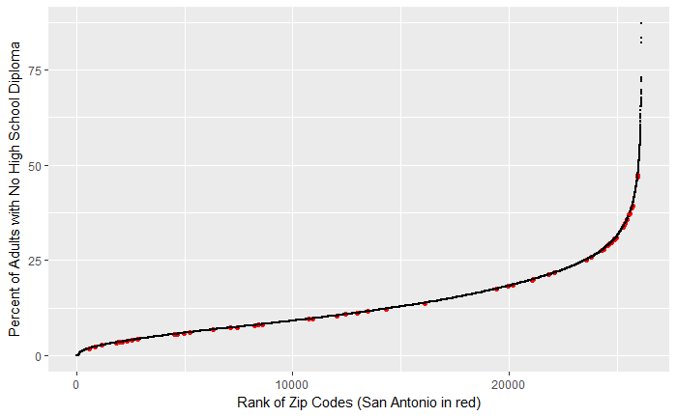

Slide 11
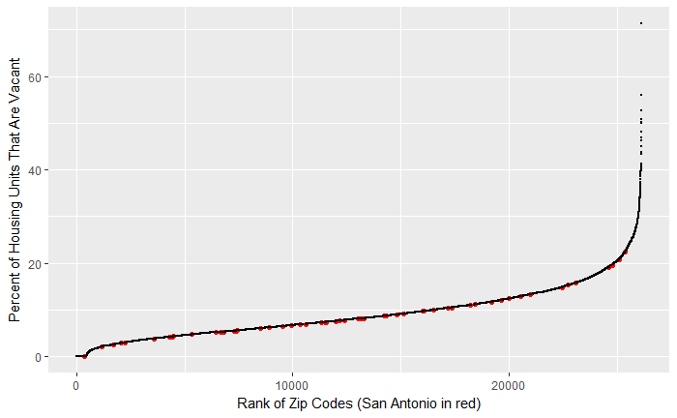

Slide 12
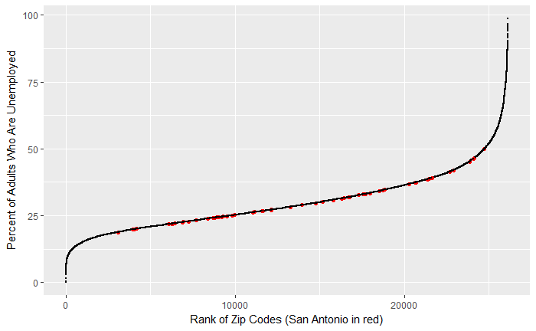

Slide 13
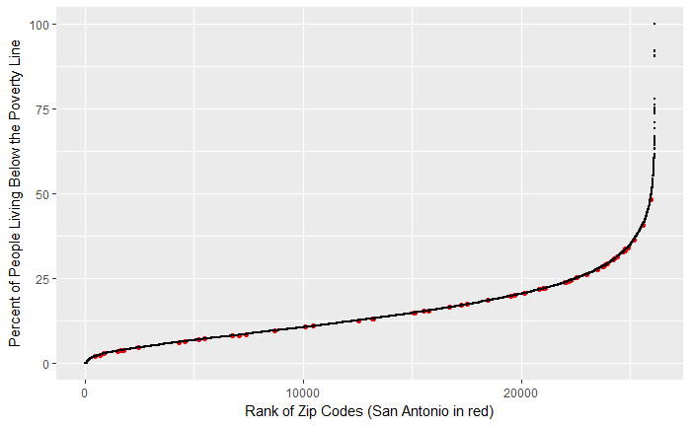

Slide 14
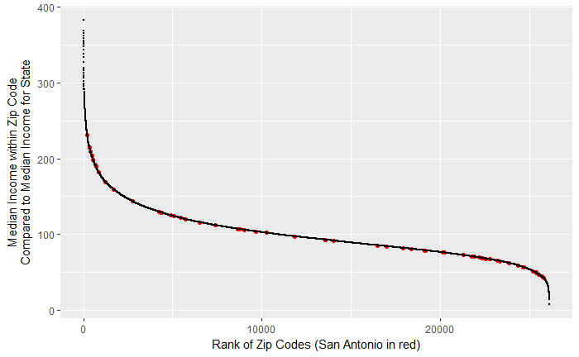

Slide 15
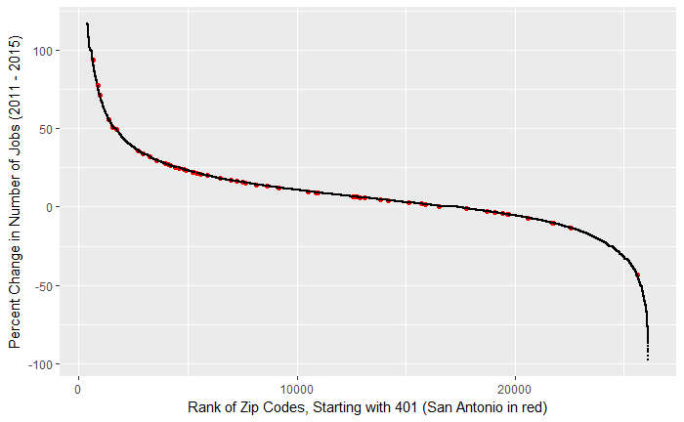

Slide 16
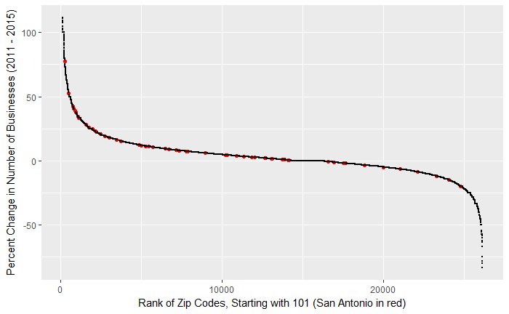

Slide 17
Additional Components
Demographics
Caucasian
African-American
Hispanic
Asian
Mixed
Geographic Information
Regions
Subregions
Land Area
Water Area
Data sources: zipwho.com and statisticalatlas.com

Slide 18
Top 5 Most Significant Variables on DCI
1. Change in Business from 2011 to 2015
2. Median Income
3. Housing Vacancy
4. Unemployment Rate
5. Poverty Rate
Notes:
Housing Vacancy - Percent of habitable housing that is unoccupied, excluding properties that are for seasonal, recreational, or occasional use.

